Slide 1


Programming with C++
Chapter 2: Decision Structures
Bujar Mamudi
Yahya Kemal College
Spring 2012

Slide 2
Contents:
Introduction
The if structure
The if/else structure
Logical Operators (!) (&&) (||)
The Conditional Operator ( ? : )
The switch Structure

Slide 3


Introduction

Slide 4
Introduction – Decision structures
When programming, just like in life, we have to make decisions, we have to choose on which path the program will continue.
Thanks to control structures (decision & repetition) we can evaluate conditions and select the flow of the program.

Slide 5
Introduction – Decision structures
In C++ there are 4 types of decisions structures:
- if evaluate condition
- if/else choose between two alternatives
- Conditional Operator ( ? :) for special cases
- switch create many alternatives, choose one

Slide 6
Rational & Equality Operators

Slide 7

Rational and Equality operators
are used to test the relation between two entities and usually return true (1) or false(0).
cout<<( 5 > 4 )<<endl;
C++ Rational and equality operators
Operator | Description | Example
> | Is greater ? | ( 5 > 4); (4 > 4); (3 > 4);
>= | Is greater or equal? | ( 5 >= 4); (4 >= 4); (3 >= 4);
< | Is smaller? | ( 5 < 4); (4 < 4); (3 < 4);
<= | Is smaller of equal? | ( 5 <= 4); (4 <= 4); (3 <= 4);
== | Is equal? | ( 5 == 4); (4 == 4); (3 == 4);
!= | Is not equal? | ( 5 != 4); (4 != 4); (3 != 4);

Slide 8
“if” structure

Slide 9
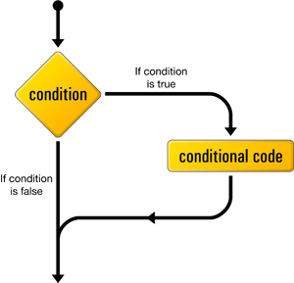
The “if” structure
used to execute(run) a statement(s) only if the given condition is true.
if ( TRUE )
{ Execute all statements inside the braces }

Slide 10
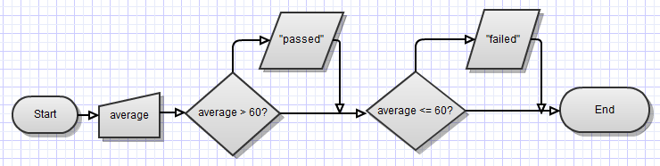
The “if” structure
Example: write a C++ program that prints “passed” if student average is above 60 and “failed” if student average is below 60.

Slide 11
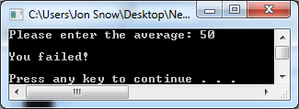
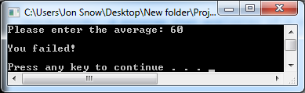
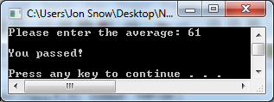
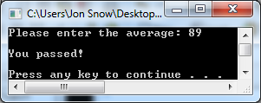
/* DESCRIPTION: A program that evaluates if a student passed or failed.
makes use of the "if" structure */
#include <cstdlib>
#include <iostream>
using namespace std;
int main(int argc, char *argv[])
{
// variable declaration
int average;
//get input from user
cout<<"Please enter the average: ";
cin>> average;
// check if average is greater than 60
if (average > 60)
{
cout<<"\nYou passed!\n\n";
}
// check if average is lower than 60
if (average <= 60)
{
cout<<"\nYou failed!\n\n";
}
system("PAUSE");
return EXIT_SUCCESS;
}

Slide 12
“if/else” structure

Slide 13
The “if/else” structure
lets the program decide which of the two statements is executed.
if ( TRUE )
{ // Execute these statements if TRUE }
else
{ // Execute these statements if FALSE }

Slide 14
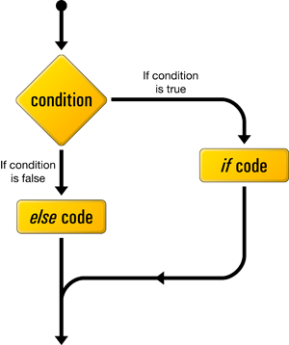
The “if/else” structure
Note: In case the if condition is true, then the else condition is skipped, and vice versa.

Slide 15
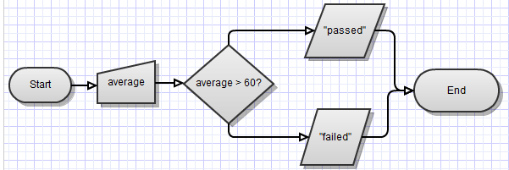
The “if/else” structure
Example: write a C++ program that prints “passed” if student average is above 60 and “failed” if student average is below 60.

Slide 16
/* DESCRIPTION: A program that evaluates if a student passed or failed.
makes use of the "if/else" structure */
#include <cstdlib>
#include <iostream>
using namespace std;
int main(int argc, char *argv[])
{
// variable declaration
int average;
//get input from user
cout<<"Please enter the average: ";
cin>> average;
// check the average
if (average > 60)
{
cout<<"\nYou passed!\n\n";
}
else
{
cout<<"\nYou failed!\n\n";
}
system("PAUSE");
return EXIT_SUCCESS;
}

Slide 17
Odd or even?
Write a C++ program that decides if a number is odd or even.
INPUT: an integer
OUTPUT: “Odd” or “Even”
Hint: even numbers are divisible by 2.
?check if there is any remainder?

Slide 18
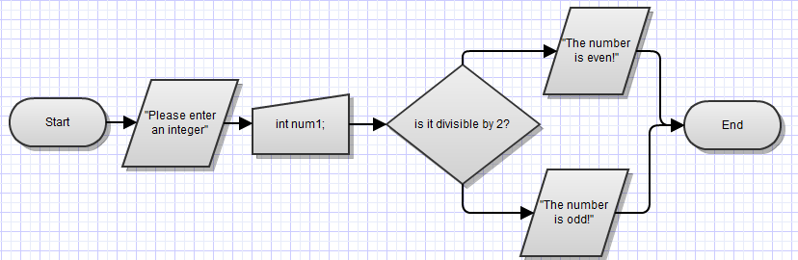
Odd or even?

Slide 19
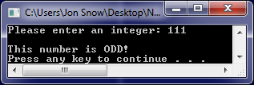
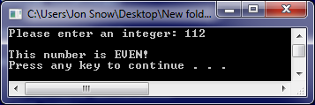
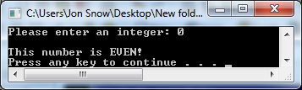
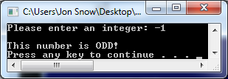
/* DESCRIPTION: a program that checks if a number is even or odd */
#include <cstdlib>
#include <iostream>
using namespace std;
int main(int argc, char *argv[])
{
//variable declaration
int num1;
//get input from user
cout<<"Please enter an integer: ";
cin>>num1;
// check if it is even or divisible by 2
if (num1 % 2 == 0)
{
cout<<"\nThis number is EVEN!\n";
}
else
{
cout<<"\nThis number is ODD!\n";
}
system("PAUSE");
return EXIT_SUCCESS;
}

Slide 20
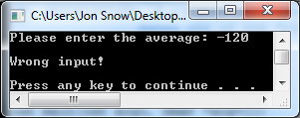
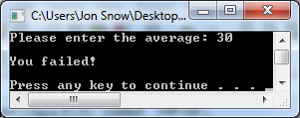
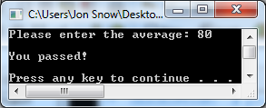
Unexpected cases
Example: write a C++ program that prints “passed” if student average is above 60 and “failed” if student average is below 60.
What if the average is less then 0?
// check the average
if (average > 60)
{
cout<<"\nYou passed!\n\n";
}
else if (average < 0)
{
cout<<"\nWrong input!\n\n";
}
else
{
cout<<"\nYou failed!\n\n";
}

Slide 21
Sign of a number
Write a C++ program that decides the sign of a number.
INPUT: an integer
OUTPUT: “Positive”, “Negative” or “Zero”

Slide 22
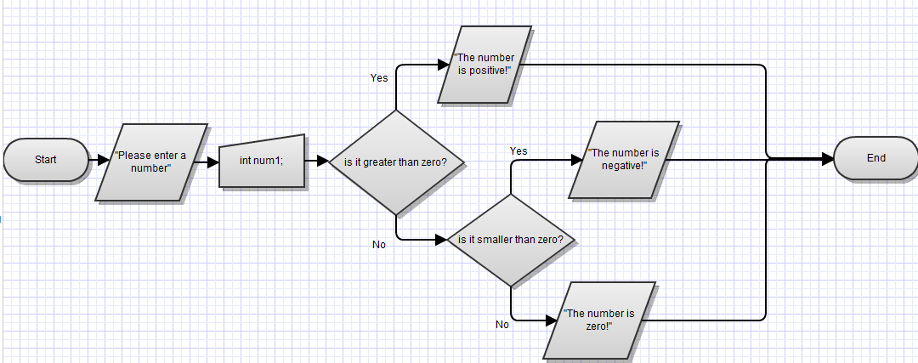
Sign of a number

Slide 23
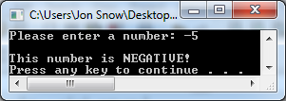
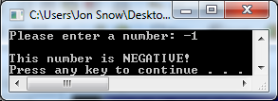
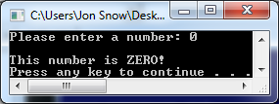
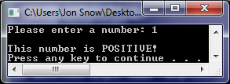
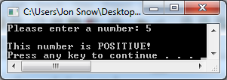
#include <cstdlib> // DESCRIPTION: A program that checks the sign of a number.
#include <iostream>
using namespace std;
int main(int argc, char *argv[])
{
//variable declaration
int num1;
//get input from user
cout<<"Please enter a number: ";
cin>>num1;
// check the sign
if (num1 < 0)
{
cout<<"\nThis number is NEGATIVE!\n";
}
else if (num1 > 0)
{
cout<<"\nThis number is POSITIVE!\n";
}
else
{
cout<<"\nThis number is ZERO!\n";
}
system("PAUSE");
return EXIT_SUCCESS;
}

Slide 24
Logical operators (!), (||), (&&)

Slide 25
Logical Operators
are used to combine many logical expressions and return true(1) or false(0).
In C++ there are three logical operators:
Operator | Name | Description | Example
! | Not | returns the opposite | !(5>4);
&& | And | returns true if both operands are true, otherwise returns false. | ((5>4) && (3 > 5));
|| | Or | returns false if both operands are false, otherwise returns true. | ((5>4) || (3 > 5));

Slide 26
Logical Not (!) Operator
is a unary operator(takes one value) and returns the opposite of it.
!(5 > 7) //evaluates to true
!true //evaluates to false
NOT Truth Table
X | !X
1 | 0
0 | 1

Slide 27
Logical And (&&) Operator
is a binary operator(takes two operands) and returns true if both of them are true, otherwise it returns false.
if ((average > 90) && (average <= 100))
{
cout<<"\nExcellent!\n\n";
}
if ((num % 3 == 0) && (num % 7 == 0))
{
cout<<"It is divisible by 3 and 7";
}
AND Truth Table
X | Y | X && Y
1 | 1 | 1
1 | 0 | 0
0 | 1 | 0
0 | 0 | 0

Slide 28
Logical Or (||) Operator
is a binary operator(takes two operands) and returns false if both of them are false, otherwise it returns true.
if ((num % 3 == 0) || (num % 7 == 0))
{
cout<<"It is divisible by 3 or 7";
}
OR Truth Table
X | Y | X || Y
1 | 1 | 1
1 | 0 | 1
0 | 1 | 1
0 | 0 | 0

Slide 29
Letter?
Write a C++ program that checks if an entered character is between ‘a’ and ‘z’ or ‘A’ and ‘Z’. In other words, check if it’s a letter or not
INPUT: One character.
OUTPUT: “It’s a letter”, or “It’s not a letter”

Slide 30
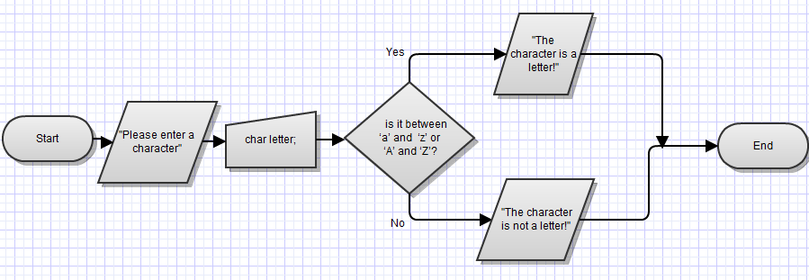
Letter?

Slide 31
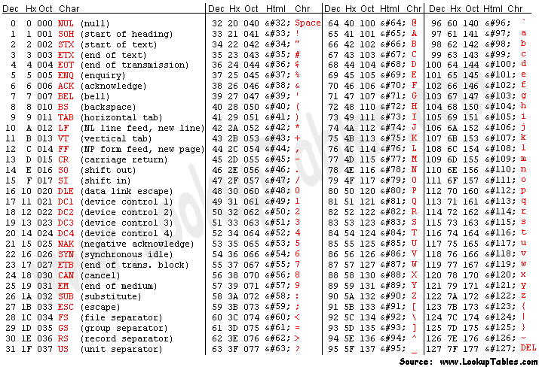

Slide 32
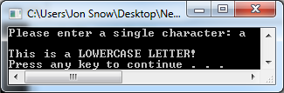
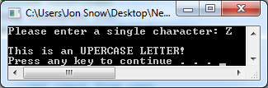
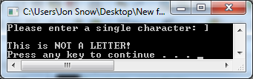
// DESCRIPTION: a program that checks if a given char is a letter
#include <cstdlib>
#include <iostream>
using namespace std;
int main(int argc, char *argv[])
{
//variable declaration
char letter;
//get input from user
cout<<"Please enter a single character: ";
cin>>letter;
// check if it is a letter
if (((int) letter >= 65 )&&((int) letter <= 90))
{
cout<<"\nThis is an UPERCASE LETTER!\n";
}
else if (((int) letter >= 97 )&&((int) letter <= 122))
{
cout<<"\nThis is a LOWERCASE LETTER!\n";
}
else
{
cout<<"\nThis is NOT A LETTER!\n";
}
system("PAUSE");
return EXIT_SUCCESS;
}

Slide 33
alternative version
// check if it is a letter
if ( ((int) letter >= 65 )&&((int) letter <= 90) ||
((int) letter >= 97 )&&((int) letter <= 122) )
{
cout<<"\nThis is a LETTER!\n";
}
else
{
cout<<"\nThis is NOT A LETTER!\n";
}

Slide 34
Leap Year
Write a C++ program that checks if a given year is a leap year or not.
INPUT: One integer year.
OUTPUT: “Leap year”, or “Not a leap year”

Slide 35
How do we calculate Leap Years?
In the Gregorian calendar 3 criteria must be met to be a leap year:
The year is evenly divisible by 4;
If the year can be evenly divided by 100, it is NOT a leap year, unless;
The year is also evenly divisible by 400. Then it is a leap year.
Divisible(4) AND ( !Divisible(100) OR Divisible(400) )
This means that 2000 and 2400 are leap years, while 1800, 1900, 2100, 2200, 2300 and 2500 are NOT leap years.

Slide 36
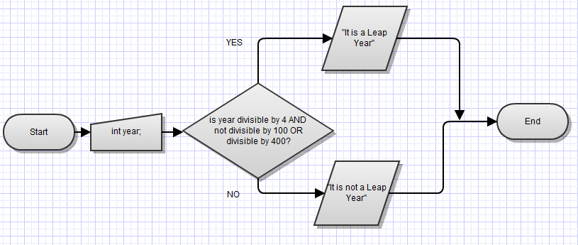

Slide 37
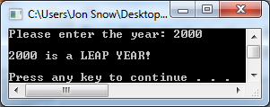

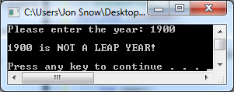
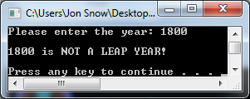
// DESCRIPTION: Check if its a leap year!
#include <cstdlib>
#include <iostream>
using namespace std;
int main(int argc, char *argv[])
{
//variable declaration
int year;
//take user input
cout<<"Please enter the year: ";
cin>>year;
if ((year % 4 == 0) && ((year % 100 != 0) || (year % 400 == 0)))
{
cout<<endl<<year<<" is a LEAP YEAR!\n\n";
}
else
{
cout<<endl<<year<<" is NOT A LEAP YEAR!\n\n";
}
system("PAUSE");
return EXIT_SUCCESS;
}

Slide 38
Leap Year
Write a C++ program that checks if a given year is a leap year or not without using logical operators.
INPUT: One integer year.
OUTPUT: “Leap year”, or “Not a leap year”
Hint: use nested if/else statements.

Slide 39
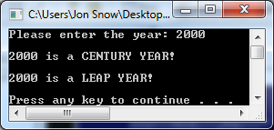
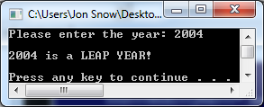
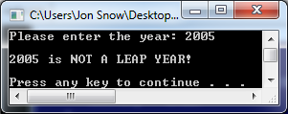
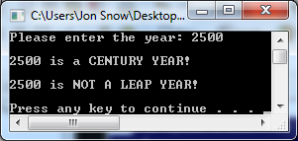
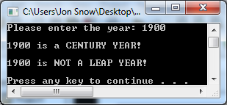
// check if it is a century
if (year % 100 ==0)
{
cout<<endl<<year<<" is a CENTURY YEAR!\n";
century = true;
}
// in case it is a century
if ( century == true)
{
// check if its also divisible by 400
if (year % 400 ==0)
{
cout<<endl<<year<<" is a LEAP YEAR!\n\n";
}
else
{
cout<<endl<<year<<" is NOT A LEAP YEAR!\n\n";
}
}
// in case its not a century
else
{
// check if its divisible by 4
if (year % 4 ==0)
{
cout<<endl<<year<<" is a LEAP YEAR!\n\n";
}
else
{
cout<<endl<<year<<" is NOT A LEAP YEAR!\n\n";
}
}

Slide 40
The Conditional Operator ( ? : )

Slide 41
The Conditional Operator ( ? : )
If we are choosing from two options based on a condition we can directly use the selective condition operator.
cout<< (( average>60 ) ? "passed\n" : "failed\n");
---------------------------------------------------------
if (average > 60)
{
cout<<"passed\n";
}
else
{
cout<<"failed!\n";
}

Slide 42
The Conditional Operator ( ? : )
cout<< (( average>60 ) ? "passed\n" : "failed\n");
First the condition (average>60) is evaluated, if true "passed\n" is shown otherwise "failed\n" is shown.
The leap year problem can be simply written as:
cout<< ((year % 400 == 0)||(year % 100 != 0) && (year % 4 == 0) ? "Leap Year" : "Not a Leap Year!");

Slide 43
“switch” structure

Slide 44
The “switch” structure
It allows us to select from multiple choices based on constant values.
If you have many “if” and “if/else” instructions to check constant values it is best to implement it by using “switch”.
switch (num1) {
case 1:
statement;
break;
case 2:
statement;
break;
default:
statement;

Slide 45
The “switch” structure
It evaluates the value of the expression and performs all the instructions starting from the true case of the expression’s value until the ending brace.
If none of the cases has the value of the expression then instructions under the default part will be executed.
The break statement at the end of the case statement tells C++ to exit the switch statement. If you forget to write it the compiler will execute the following statements also.

Slide 46
Name of the month
Example: Write a C++ program that reads the order of a month and prints its name.

Slide 47
//DESCRIPTION: a program that takes the number of a month and prints its name
#include <cstdlib>
#include <iostream>
using namespace std;
int main(int argc, char *argv[])
{
//variable declaration
int month;
//get input from user
cout<<"Please enter the month number: ";
cin>>month;
// perform the switch structure for month number
switch(month)
{
case 1:
cout<<"\nIt is January!\n\n";
break;
case 2:
cout<<"\nIt is February!\n\n";
break;
case 3:
cout<<"\nIt is March!\n\n";
break;
case 4:
cout<<"\nIt is April!\n\n";
break;

Slide 48
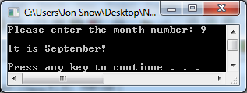
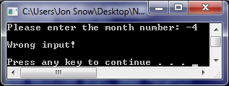
case 5:
cout<<"\nIt is May!\n\n";
break;
case 6:
cout<<"\nIt is June!\n\n";
break;
case 7:
cout<<"\nIt is July!\n\n";
break;
case 8:
cout<<"\nIt is August!\n\n";
break;
case 9:
cout<<"\nIt is September!\n\n";
break;
case 10:
cout<<"\nIt is October!\n\n";
break;
case 11:
cout<<"\nIt is November!\n\n";
break;
case 12:
cout<<"\nIt is December!\n\n";
break;
default :
cout<<"\nWrong input!\n\n";
}
system("PAUSE");
return EXIT_SUCCESS;
}

Slide 49
Days in a month
Example: Write a C++ program that reads the order of a month and prints how many days it has.

Slide 50
//DESCRIPTION: a program that takes the number of a month and prints how many days it has
#include <cstdlib>
#include <iostream>
using namespace std;
int main(int argc, char *argv[])
{
//variable declaration
int month;
//get input from user
cout<<"Please enter the month number: ";
cin>>month;
// perform the switch structure for month number
switch(month)
{
case 1:
cout<<"\nJanuary has 31 days!\n\n";
break;
case 2:
cout<<"\nFebruary has 28-29 days!\n\n";
break;
case 3:
cout<<"\nMarch has 31 days!\n\n";
break;
case 4:
cout<<"\nApril has 30 days!\n\n";
break;

Slide 51
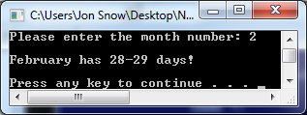
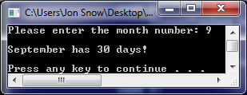
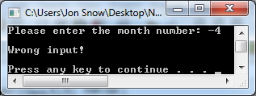
case 5:
cout<<"\nMay has 31 days!\n\n";
break;
case 6:
cout<<"\nJune has 30 days!\n\n";
break;
case 7:
cout<<"\nJuly has 31 days!\n\n";
break;
case 8:
cout<<"\nAugust has 31 days!\n\n";
break;
case 9:
cout<<"\nSeptember has 30 days!\n\n";
break;
case 10:
cout<<"\nOctober has 31 days!\n\n";
break;
case 11:
cout<<"\nNovember has 30 days!\n\n";
break;
case 12:
cout<<"\nDecember has 31 days!\n\n";
break;
default :
cout<<"\nWrong input!\n\n";
}
system("PAUSE");
return EXIT_SUCCESS;
}

Slide 52
Traffic Lights
Example: Write a C++ program that reads a character from the user indicating the color of the light and sends a comment to the user.
INPUT: ‘r’, ‘y’, or ‘g’
OUTPUT: “WAIT”, “GET READY”, “GO” or
“WRONG INPUT”

Slide 53
//DESCRIPTION: a program that takes the color of traffic light and displays message
#include <cstdlib>
#include <iostream>
using namespace std;
int main(int argc, char *argv[])
{
//variable declaration
char color;
//get input from user
cout<<"Please enter the first letter of the color of traffic lights[r,y,g]: ";
cin>>color;
// perform the switch structure for color char
switch(color)
{
case 'r':
cout<<"\nWAIT!\n\n";
break;
case 'y':
cout<<"\nGET READY!\n\n";
break;
case 'g':
cout<<"\nGO!\n\n";
break;
default :
cout<<"\nWrong input!\n\n";
}
system("PAUSE");
return EXIT_SUCCESS;
}

Slide 54
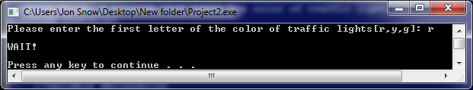
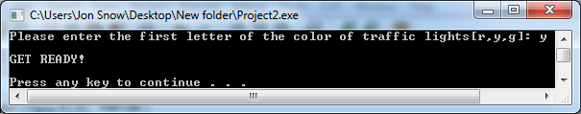
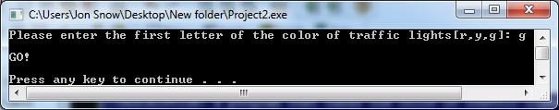
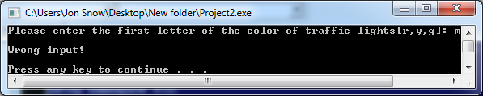

Slide 55
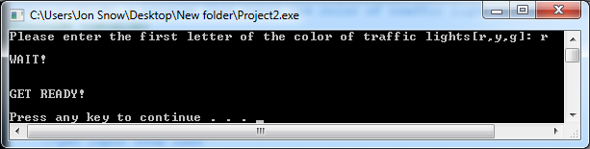
switch(color)
{
case 'r':
cout<<"\nWAIT!\n\n";
//break;
case 'y':
cout<<"\nGET READY!\n\n";
break;
case 'g':
cout<<"\nGO!\n\n";
break;
default :
cout<<"\nWrong input!\n\n";
}

Slide 56
Summary

Slide 57
Summary
We need decision structure in order to give direction to the program flow.
We execute or skip a statement block by using the simple if statement.
We choose one of two options by using the if/else structure.

Slide 58
Summary
C++ provides three kind of logical operators in order to combine logical expressions and evaluate them.
Not Operator (!)
And Operator (&&)
Or Operator (||)
Conditional Operator ( ? : )

Slide 59
Summary
Several if, if/else structures can be expressed by using a switch structure.
If we have a case that an expression may have constant values, it is best to check them by a switch instead of if/else structure.

Slide 60
Review Questions

Slide 61
What are the outputs of the code segment?
if(c1)
if(c2)
cout<<"if"<<endl;
else
cout<<"if/else"<<endl;
else if (!c2)
cout <<"?"<<endl;
else
cout<<"switch"<<endl;
c1 | c2 | Output
True | True | If
True | False | If/else
False | True | switch
False | False | ?

Slide 62
The given code copies the bigger of two variables to the third one. Rewrite it by using if/else.
c = (a > b) ? a : b;
if ( a > b)
{
c = a;
}
else
{
c = b;
}

Slide 63

What is the final value of x?
int x = 1;
if ( x >= 0) x += 5;
if ( x >= 5) x += 2;
else x *= 3;
cout<<x<<endl;

Slide 64
Which of the values for weight and height cause the message “over weight” to be printed?
if ( weight+110 < height)
cout << "normal weight"<< endl;
else
cout << "over weight" <<endl;
Input | Output
weight = 50, height = 155; | over weight
weight = 80, height = 192; | normal weight
weight = 25, height = 125; | over weight

Slide 65
What is the result of these logical expressions?
a | b | c | Expression | Result
5 | 3 | 1 | c && ( a > b ) | 1
0 | 4 | 4 | ( b == c )||a | 1
0 | 5 | 4 | ( (!a) && ( b != c)) && (b <=c ) | 0
4 | 2 | 3 | ( a > b ) && ( c < a) | 1

Slide 66
Fix the code to get the correct mark for the given scores.
if ( avg > 0 )
mark = F;
else if ( avg > 20 )
mark = D;
else if ( avg > 40 )
mark = C;
else if ( avg > 60 )
mark = B;
else if ( avg > 80 )
mark = A;
0 | 20 | F
21 | 40 | D
41 | 60 | C
61 | 80 | B
81 | 100 | A

Slide 67
Fix the code to get the correct mark for the given scores.
if ( avg < 0)
cout<<"\nWrong input!";
else if ( avg <= 20)
mark = 'F';
else if ( avg <= 40 )
mark = 'D';
else if ( avg <= 60 )
mark = 'C';
else if ( avg <=80 )
mark = 'B';
else if ( avg <= 100 )
mark = 'A';
else
cout<<"\nWrong input!";
0 | 20 | F
21 | 40 | D
41 | 60 | C
61 | 80 | B
81 | 100 | A

Slide 68
Alternative version.
if (( avg >= 0 ) && ( avg <= 20 ))
mark ='F';
else if (( avg > 20 ) && ( avg <= 40 ))
mark ='D';
else if (( avg > 40 ) && ( avg <= 60 ))
mark ='C';
else if (( avg > 60 ) && ( avg <= 80 ))
mark ='B';
else if (( avg > 80 ) && ( avg <= 100 ))
mark ='A';
else
cout<<"Wrong Input!";
0 | 20 | F
21 | 40 | D
41 | 60 | C
61 | 80 | B
81 | 100 | A

Slide 69
Programming Problems

Slide 70


Roots of quadratic equation
Write a C++ program that takes as input three integers (a, b, c) as coefficients of the quadratic equation and calculates the two roots (x1, x2).

Slide 71
Mini calculator
Write a C++ program that reads two operands(numbers) and a character as an operator between them and prints the result.
INPUT: 3 * 7
OUTPUT: 21

Slide 72
Character Recognizer
Write a C++ program that reads a character and tells the user if it is a letter(‘a’…’z’, ’A’…’Z’), a digit(‘0’…’9’), a punctuation mark(‘.’ … ‘!’), or special character(other than these).

Slide 73
Positive
Write a C++ program that asks the user for an integer and prints “Positive” if the integer is bigger than zero.

Slide 74
Sum
Write a C++ program that gets two numbers and then prints the sum of these numbers only if the first is bigger than the second.

Slide 75

Triangle
Write a C++ program that gets three numbers and then determines if these numbers represent possible side lengths of a triangle.

Slide 76
Programming with C++
?
?
?
?
?
Questions?
?
?
?
?
?
© 2012 Bujar Mamudi

